Slide 1
MODULE 2: BASELINE ASSESSMENT
Session 16: Storing Baseline Data
Notes:
Storing Baseline Data

Slide 2
How is Baseline Data Stored?
Baseline data is stored using the Baseline Storage Sheet
Session 16: Storing Baseline Data

Slide 3
What is the Baseline Storage Sheet?
The Baseline Storage Spreadsheet is a simple Excel spreadsheet that enables field teams to
enter, check and analyze individual interview data in the field.
Session 16: Storing Baseline Data

Slide 4
What is the Baseline Storage Sheet?
It is also the basic tool that field teams use to analyze and summarize all the field data during the interim and final data analysis sessions.
Session 16: Storing Baseline Data

Slide 5
What is the Baseline Storage Sheet?
It has space to record the results from two levels of interview:
community level
household representative
Session 16: Storing Baseline Data

Slide 6
What is the advantage of using the Baseline Storage Sheet?
The Baseline Storage Spreadsheet:
encourages active checking and cross-checking of data by the field teams
facilitates rapid on-the-spot analysis, so that any inconsistencies or questions can be resolved by the field teams before they leave the survey area
Session 16: Storing Baseline Data

Slide 7
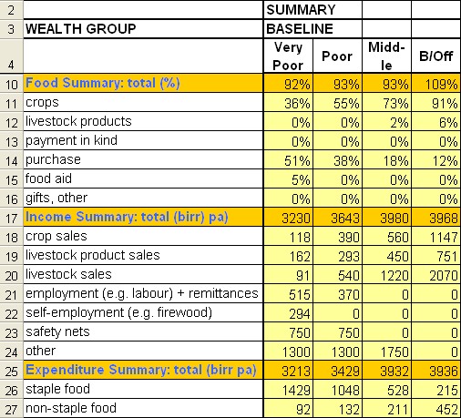
Cross-checks built into the Baseline Storage Sheet
First, the summary of total food for a wealth group must equal at least 90% of 8800 kJ ppd
Session 16: Storing Baseline Data
Notes:
Be prepared to answer why only 90%?
While the guiding principle of 100% is still applicable, is not always possible however, since it is not unusual for average total food intake (for the poor especially) to fall below 100% in the reference year (if 8800 kJ is set as the minimum). Anything less than an average of 90% is unusual, however, and indicates that one or more sources of food may have been missed or under-estimated. At the level of the individual interview, a total of less than 85% can be taken as indicating an unsatisfactory interview.
Storing Baseline Data

Slide 8
Cross-checks built into the Baseline Storage Sheet
Second, income must at least cover expenditure
Session 16: Storing Baseline Data
Notes:
A difference between the two of more than 10% indicates the need for further follow-up, both during the interview and at the stage of analysing the data.
Storing Baseline Data

Slide 9
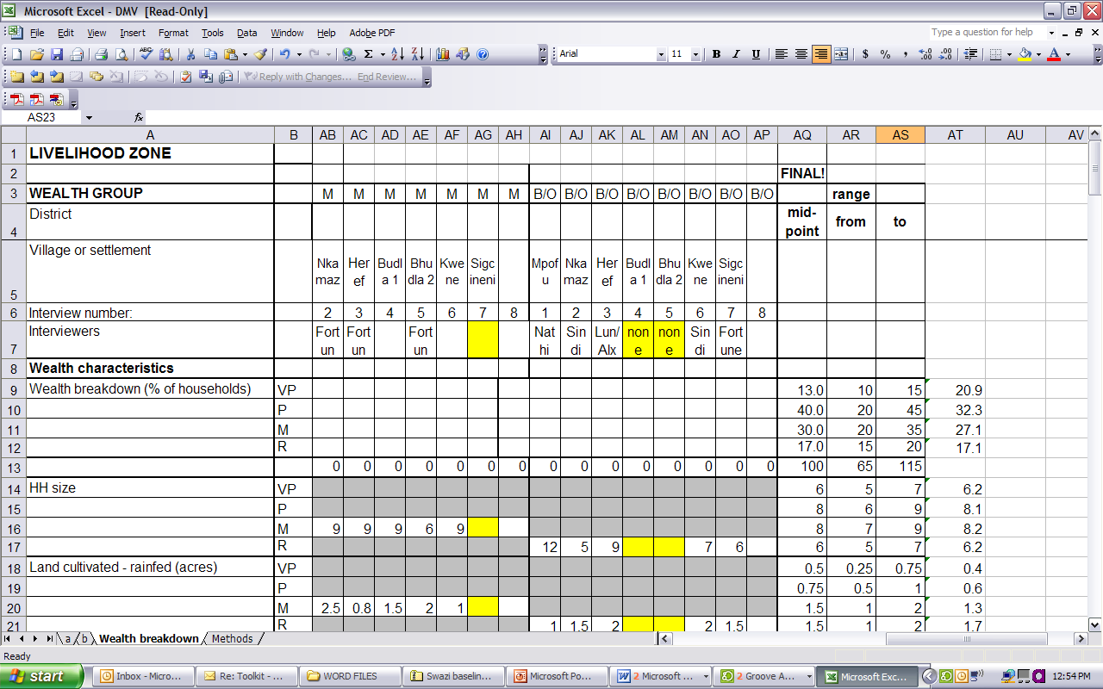
Cross-checks built into the Baseline Storage Sheet
Third, trends across wealth groups are checked.
E.g. Acres culti-vated increase with wealth
Session 16: Storing Baseline Data
Notes:
Storing Baseline Data

Slide 10
Cross-checks built into the Baseline Storage Sheet
Trends across wealth groups are checked. (cont.) For example:
Herd size should increase with wealth
Other asset holdings should increase with wealth
Yield per acre may increase with wealth
Session 16: Storing Baseline Data
Notes:
Storing Baseline Data

Slide 11
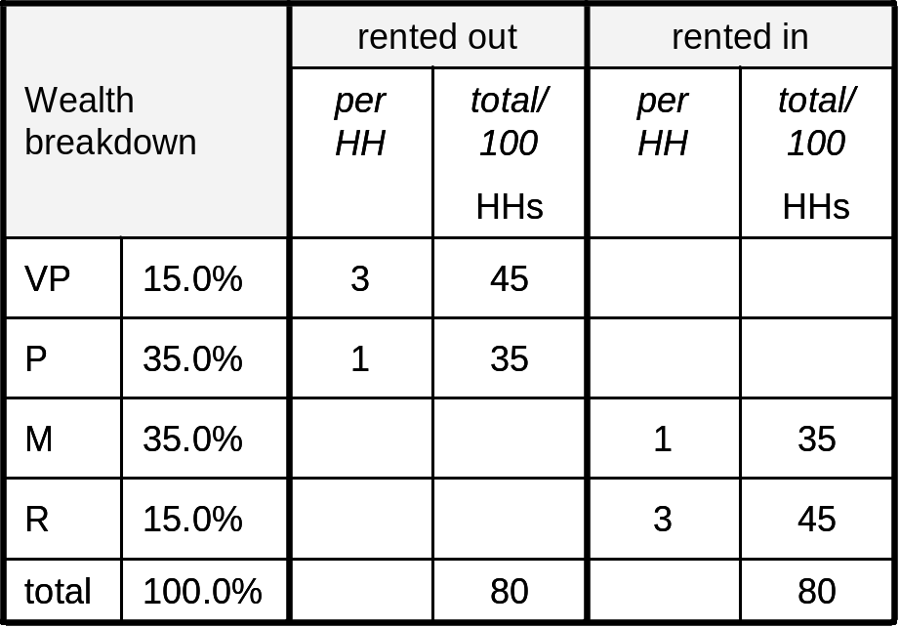
Cross-checks built into the Baseline Storage Sheet
Fourth, the balance between supply and demand can be checked:
For instance, land rented in must balance with land rented out
Session 16: Storing Baseline Data
Notes:
Storing Baseline Data

Slide 12
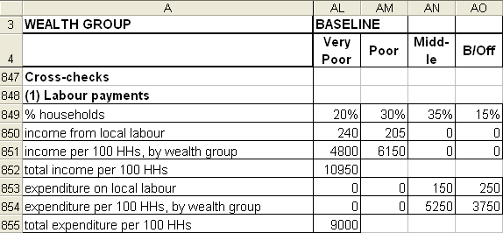
Cross-checks built into the Baseline Storage Sheet
Fourth, the balance between supply and demand can be checked:
And local ag. labour income for the poorer should more or less match exp. on labour for the better off
Session 16: Storing Baseline Data
Notes:
Where there is a big difference between the two figures, there is usually a need to re-examine the individual interview data a little more carefully. The most likely reasons for income exceeding expenditure are a) over-estimation of the percentage of households in the poorer wealth groups and b) over-estimation of cash income from labour (i.e. an over-estimation of the number of people engaged per household, or the number of days worked per month, etc.).
Storing Baseline Data

Slide 13
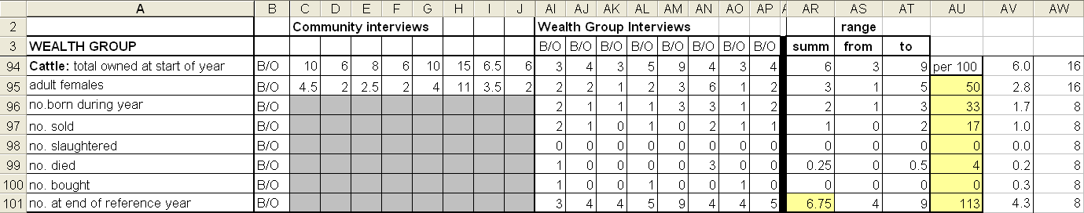
Cross-checks built into the Baseline Storage Sheet
Fifth, a herd dynamics cross-check is built into the spreadsheet
Session 16: Storing Baseline Data
Notes:
Storing Baseline Data

Slide 14
What is the process for entering data?
Individual interviews are entered as follows:
During the interview, the field interviewer completes own calculations
That evening, the team leader enters data into the Baseline Storage Sheet
Session 16: Storing Baseline Data
Notes:
Storing Baseline Data

Slide 15
What is the process for entering data?
Individual interviews are entered as follows:
The Baseline Storage Sheet automatically calculates total food and cash income and total expenditure for immediate comparison with the pencil-and-paper calculations of the interviewer
Session 16: Storing Baseline Data
Notes:
Storing Baseline Data

Slide 16
What is the process for entering data?
The next step is to summarise the results for each wealth group.
Two types of comparison are then made:
a) individual interview results within each wealth group; and
b) trends across wealth groups.
Session 16: Storing Baseline Data
Notes:
Storing Baseline Data

Slide 17
What is the process for entering data?
A final cross-check of the results should then be carried out by an experienced supervisor who was not a member of the field team. This can be done either in the field (by a roving supervisor) or at a centralised post-field work analysis session.
Session 16: Storing Baseline Data
Notes:
Storing Baseline Data

